Slide 1
Experimental Study of Solitary Wave Evolution over A 3D Shallow Shelf
Patrick Lynett, David Swigler, Sangyoung Son, Duncan Bryant, Scott Socolofsky
Coastal and Ocean Division, Zachry Department of Civil Engineering

Slide 2
Purpose
Limited available experimental data to compare numerical models with the nearshore, turbulent dynamics of a nonlinear long wave
Need for a 3D tsunami-like dataset, with turbulence measurements

Slide 3
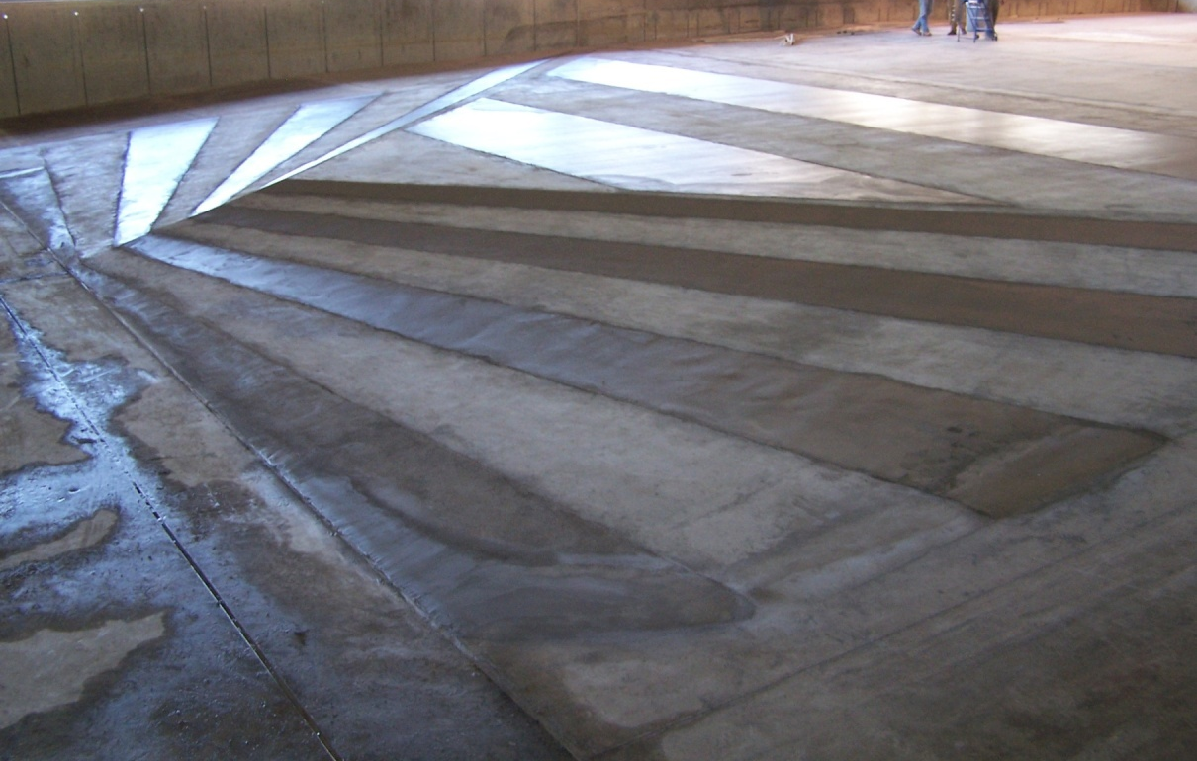
Experiment#1 Setup
Basin:
48.8m x 26.5m x 2.1m
Piston-type wavemaker
Bridge spanning width
of basin
Complex shelf
Planar beach
Water depth: 0.78m

Slide 4
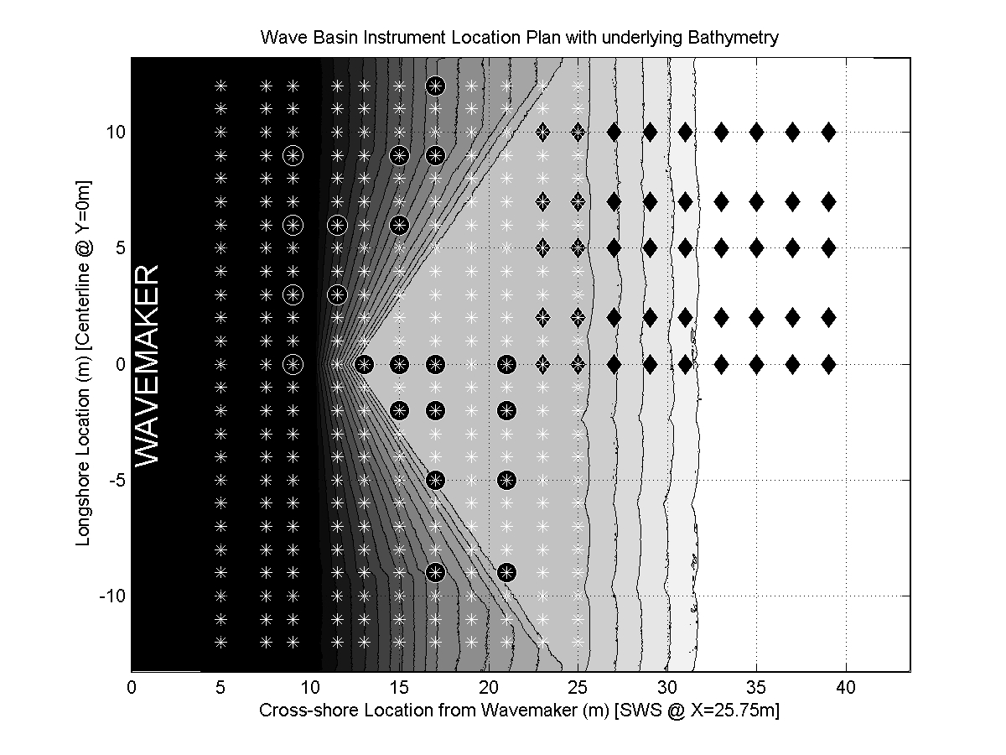
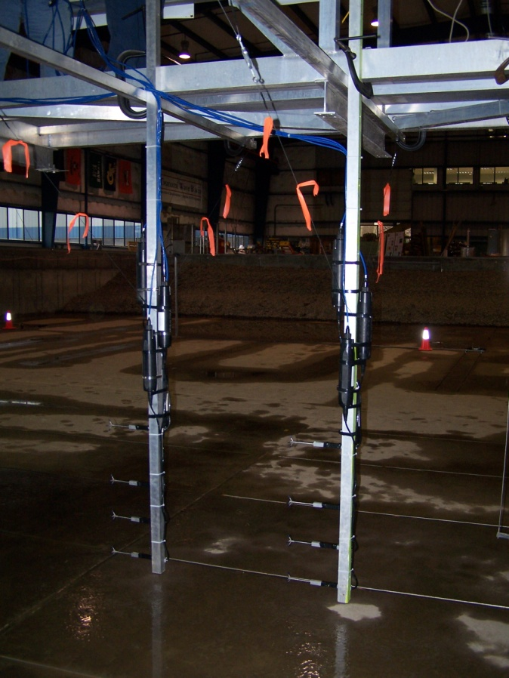
Instrument Layout
: 21 acoustic-Doppler velocimeter (ADV) array locations
↑: 275 wave gauge (WG) locations
: 45 ultra-sonic wave gauge (usWG) locations

Slide 5
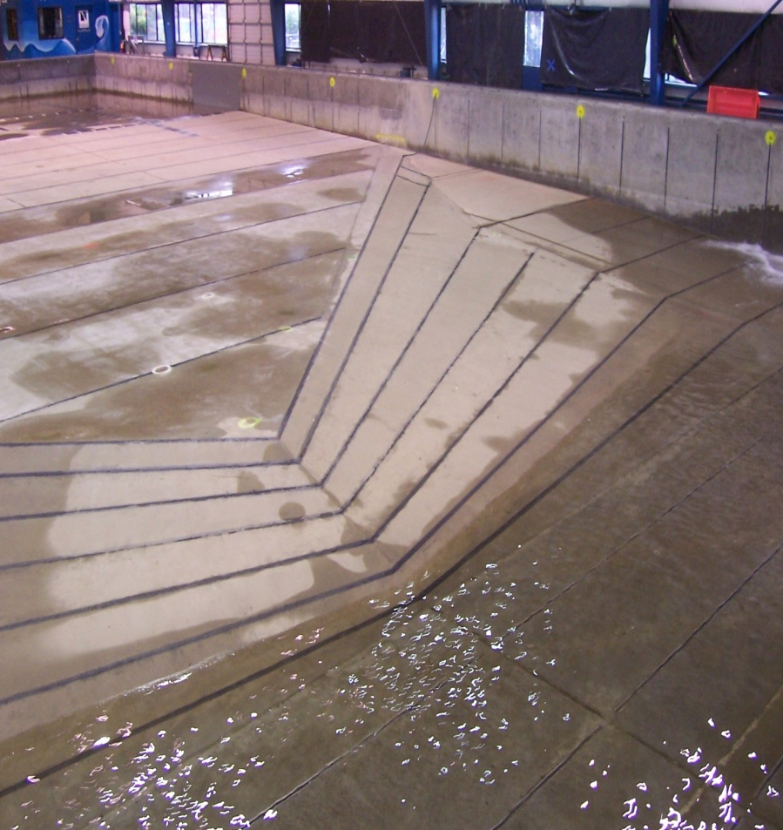
Experiment Procedure
Generated a single solitary wave (H=0.39m, depth=0.78m) for each trial
Trial consisted of a 45 second timeseries beginning w/ wave generation
20 trials for each ADV location
2 trials for each WG & usWG location

Slide 6
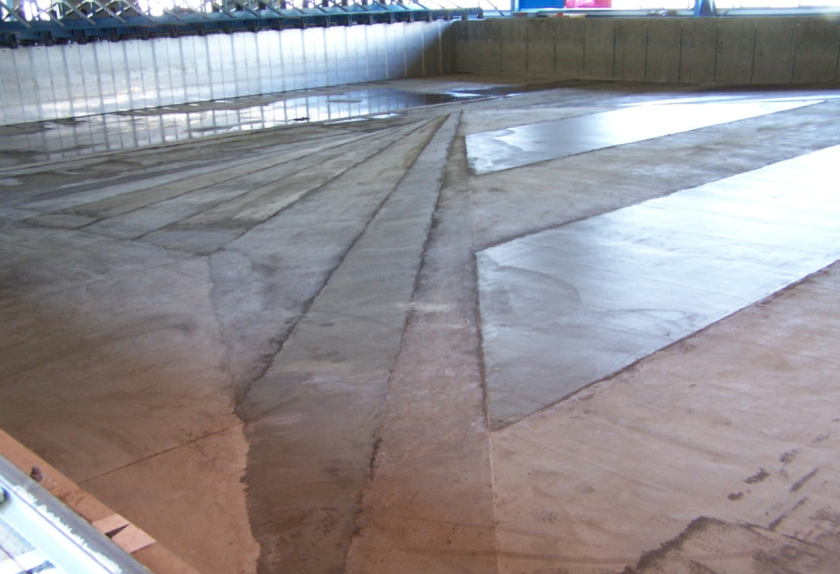
Experiment#1 Setup

Slide 7
Experiment#1 Setup

Slide 8
Basin Hydrodynamics
http://ceprofs.tamu.edu/plynett/isec/Movie_Dye.wmv

Slide 9
Basin Hydrodynamics – WG Data

Slide 10
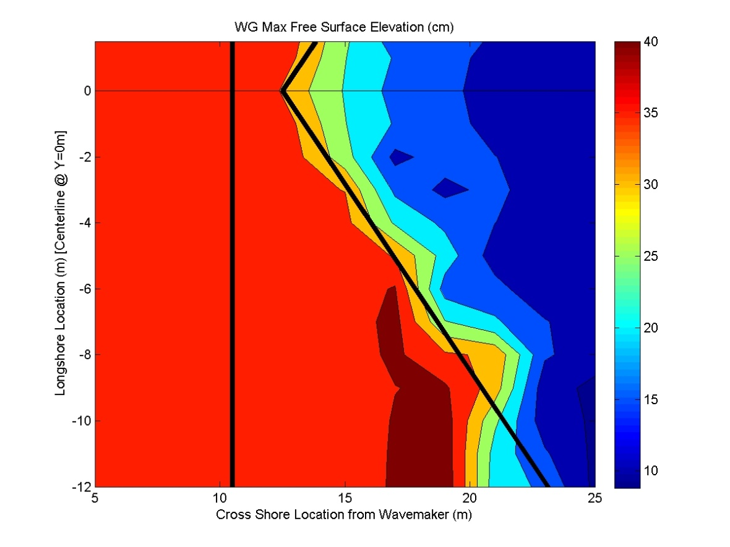
Max Free Surface Elevation
Shoaling
Negligible offshore and at shelf apex
Significant near basin side wall
Breaking
Rapid decay in wave height near shelf edge
Continued as Borefront (1) propagated shoreward

Slide 11
Refraction
Dye revealed
Pathlines behind leading wave
Enhanced mixing within the front
Refraction due to bathymetry of shelf
Directed toward centerline of basin
Not particularly evident in the breaking front
Very clear in the following onshore flow

Slide 12
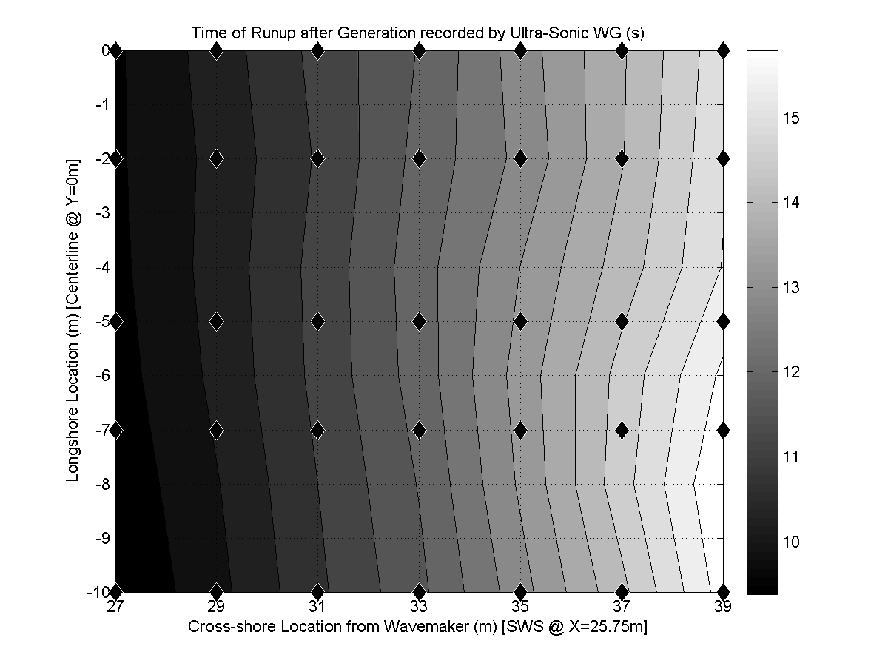
Wave Runup
Nonuniform in longshore direction due to refraction
@ X=29m: arrives first near basin side wall
@ X=39m: arrives first along basin centerline
http://ceprofs.tamu.edu/plynett/isec/Movie_Runup.wmv

Slide 13
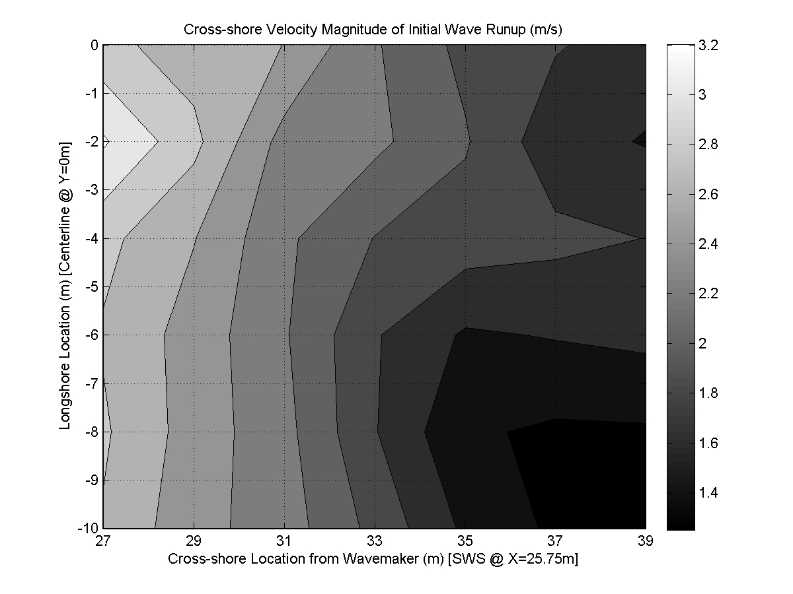
Wave Runup
Greatest cross-shore velocity along centerline due to jetting mechanism
Forcing causing convergence relaxed
Mass of water spread laterally and shoreward
http://ceprofs.tamu.edu/plynett/isec/Movie_Runup.wmv

Slide 14
Kinematics @ Shelf Apex
All values in cm/s
http://ceprofs.tamu.edu/plynett/isec/Movie4.wmv

Slide 15
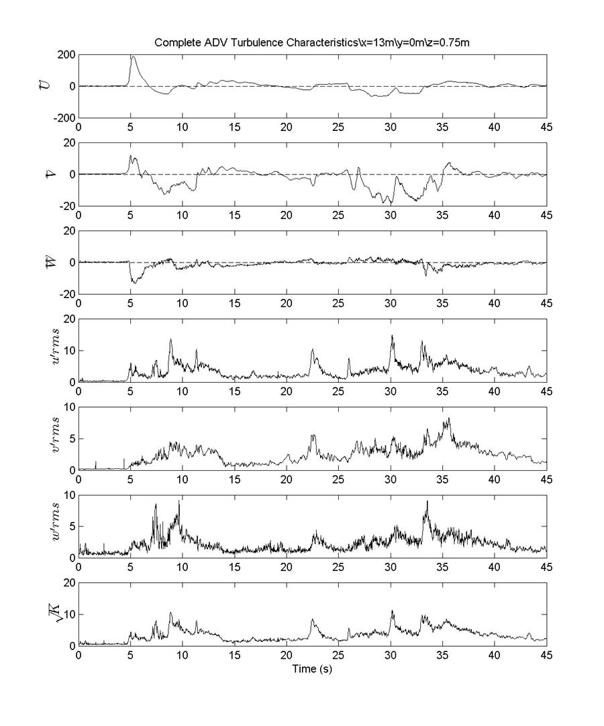
Turbulent Energy @ (X=13,Y=0)
All values in cm/s

Slide 16
Turbulent Energy @ (X=13,Y=0)
All values in cm/s

Slide 17
Coherent Structure
Green dye reveals eddy
Flow directed away from centerline @ 27s due to eddy’s arrival
Flow directed toward centerline starting @ 29s after the eddy’s center passes
Increased turbulent energy after 26s due to eddy
http://ceprofs.tamu.edu/plynett/isec/Movie8.wmv

Slide 18
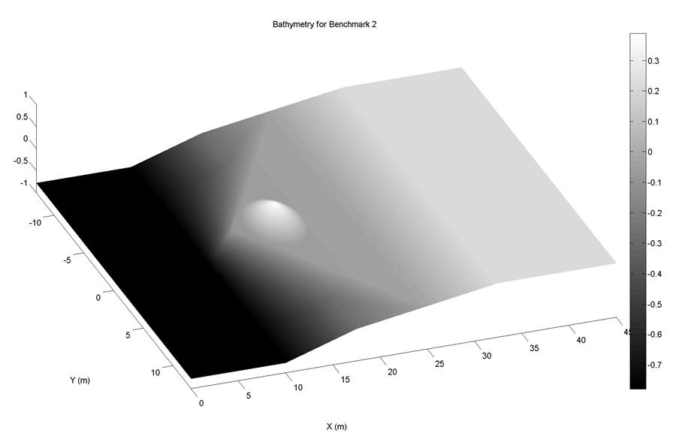
Experiment #2: Bottom Layout
Add a bump to the apex of the shelf

Slide 19
Future Work – This Summer
Add a bump to the apex of the shelf
http://ceprofs.tamu.edu/plynett/isec/P_NEEStsunamos3.E_DyeStudy.T_Trial06.cam11.avi

Slide 20
Second Experiment – Add Obstacle
Surface PIV Study
20 gallons of 2.5 mm D, 0.9 S plastic spheres
Camera mounted on bridge, looking down
10 overlapping FOV’s

Slide 21
Second Experiment – Add Obstacle
Add a bump to the apex of the shelf

Slide 22
Nearshore Dynamics of Long Waves
Transient long waves undergo complex processes in shallow water
Nonlinear, turbulent
“Single” incoming wave quickly leads to numerous waves
Developing models at the same time, these are experiments necessary to validate them
Many thanks to the staff at OSU – Tim Maddux, Sungwon Shin, Linda Fayler, Jason Killian

Slide 23
Repeatability
WGs closest to wavemaker (along X=5m)
Total of 28 trials overlaid
Measured wave height between 0.36m-0.38m
Solitary wave @ 1.3s
Trough @ 3.0s
Secondary wave @ 3.8s

Slide 24
ADV Filtering
Filter 1: SNR > 10 decibels
Filter 2: COR > 70%
Filter 3: Curvature
Shoreward of shelf edge: <300 m/s³
Offshore of shelf edge: <175 m/s³
Filter 4: ≥ 10 trials to quantify turbulence

