Slide 1
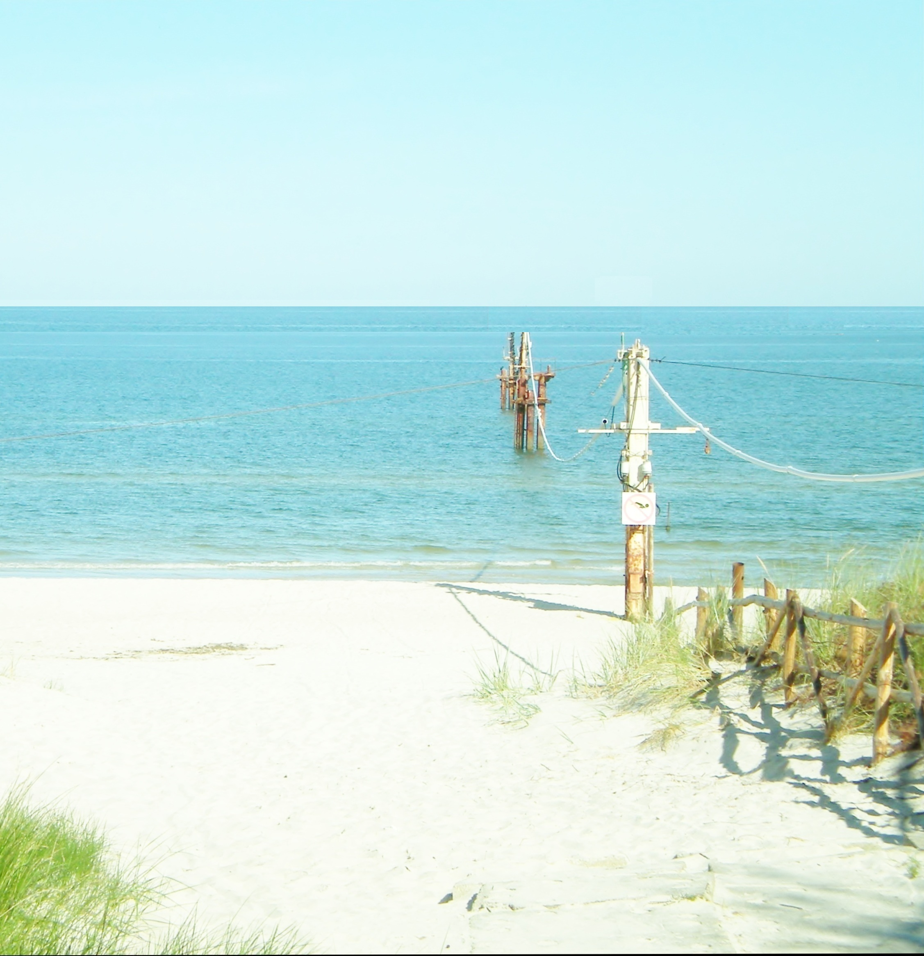
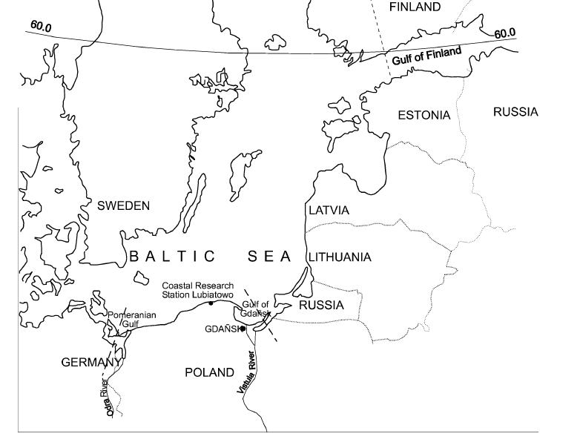
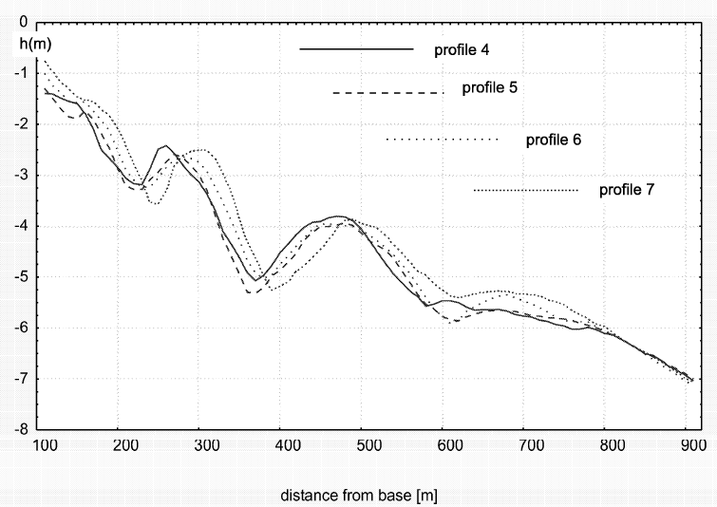
Wave transformation patterns at a non-tidal, dissipative beach
Antonios Valsamidis¹, Grzegorz Różyński ², Dominic Reeve¹
¹ College of Engineering, Swansea University, Wales, UK
² Inst. Hydroengineering (IBW PAN), Polish Acad. Sci., Gdańsk, POLAND
Introduction - Methodology:
Erosion problems may be related to anthropogenic interventions in the coastal environment. Taking into account that the interest for the exploitation of beaches is steadily rising, gaining insight into the mechanism of seabed evolution is very important.
We opted to use the sophisticated statistical method of Canonical Correlation Analysis (CCA) at Lubiatowo in Poland (Fig.1) which has a non-tidal beach with multiple longshore bars (Fig.2). The Coastal Research Station(CRS) at Lubiatowo provided us with 28 consecutive surveys of nearshore bed topography conducted between 1987-2001, complemented by hourly measurements of wave height (Hs) and peak wave period (Tp) for the same time span.
The CCA maximizes the correlation between two data sets: A and B, and specifies the degree that A accounts for the variance of B. In other words, it describes the cause-effect relationship between A and B respectively. In our study, cause is considered to be a data set of wave steepness transformations over the 28 consecutive bathymetric surveys of seabed(1987-2001), while effect is the data set of those 28 bathymetric surveys. The consequent application of the CCA revealed crucial wave transformations patterns related to seabed evolution. In the past, this method has also been used in the coastal field by Larson et al. (2000). Różyński (2003) also used the CCA to find a correlation between components of a multibar system and the interaction between the multiple longshore bars. Elsewhere, Horrillo–Caraballo and Reeve (2008) examined the performance of CCA-based at Duck (USA).
.
Results:
Fig.3 presents a graphical comparison between the standard deviations (SD) of the seabed profile derived by field measurements, and standard deviations (SD) of a corresponding reconstruction of the seabed profile produced by the CCA.
Fig.4 presents the separate analysis of the 1st CCA mode. The peaks in boxes show areas where the 1st CCA mode explains most of seabed’s variance. These peaks correspond to bars’ crests: bar 3 (middle and right hand side box) . Wave classes with wave height H(m)= 2.25, 2.75, 3.25, 3.75, 4.25 follow these wave transformation patterns!
According to Fig.5, the 2nd mode corresponds to wave transformations over bar 3 (right hand side box) and then over bar 2 (middle and left hand side box) Waves here are somewhat smaller than for mode 1, because they begin affecting seabed closer to the shoreline. Wave classes of H(m)=2.25, 2.75, 3.25 follow these wave transformation patterns.
Fig.3
Fig.4
Fig.1 The Lubiatowo beach on the map.
`
Fig.5
Fig.2 Cross- shore profiles at Lubiatowo beach showing the multiple bars.
REFERENCES
Horrillo-Caraballo and Reeve (2008): An investigation of the link between beach morphology and wave climate at Duck, NC, USA, Journal of Flood Risk Management, Blackwell Publishing Ltd, vol. 1(2), pp. 110-122.
Larson, Capobianco and Hanson (2000): Relationship between beach profiles and waves at Duck, North Carolina, determined by canonical correlation analysis, Marine Geology, ELSEVIER, vol. 163, pp. 275-288.
Różyński (2003): Data-driven modeling of multiple longshore bars and their interactions, Coastal Engineering, ELSEVIER, vol. 48, pp. 151-170.
150
250
350
450
550
650
750
Fig. 8 Power outputs from the downstream turbine in a three-turbine array for different array arrangements
Main Conclusion:
The application of the CCA revealed hydrodynamic patterns hidden in a vast amount of field data. Patterns in wave transformation were strongly linked to changes in configuration of the multiple bar profile.

