Slide 1
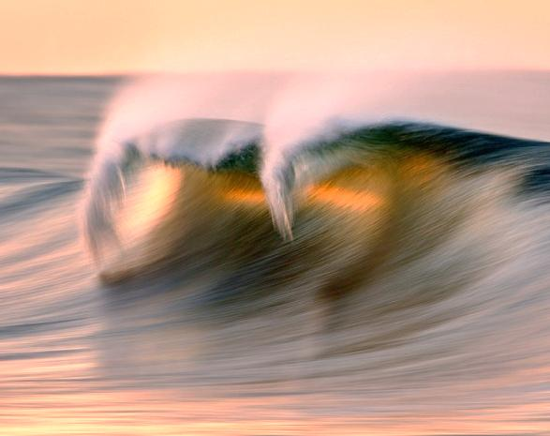
ICCE2012, Santander, Spain, July 1-6, 2012
Stability formula of tetrapod incorporating slope effect
Kyung-Duck Suh, Jin Sung Kang
Seoul National University
Notes:
Thank you, chairman. Good morning, everyone. The title of my paper is …

Slide 2
Contents
Background and purpose of research
Hydraulic experiment
Development of stability formula
Verification of stability formula
Uncertainty of stability formula
Conclusion
Seoul National University
Stability formula of Tetrapod incorporating slope effect
Notes:
This is the contents of my presentation. Background and purpose …

Slide 3
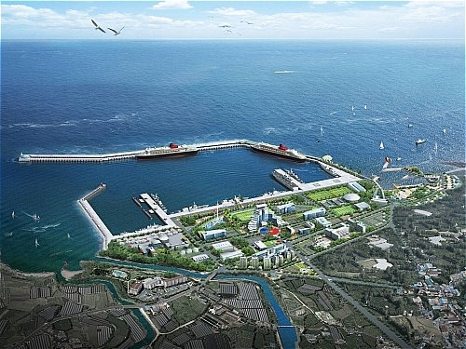
Background and purpose
We need a breakwater for:
Harbor tranquility
Safe navigation and berthing of vessels
Protection of harbor facility and passenger
Seoul National University
Stability formula of Tetrapod incorporating slope effect
Notes:
Everybody knows that we need a breakwater for …

Slide 4
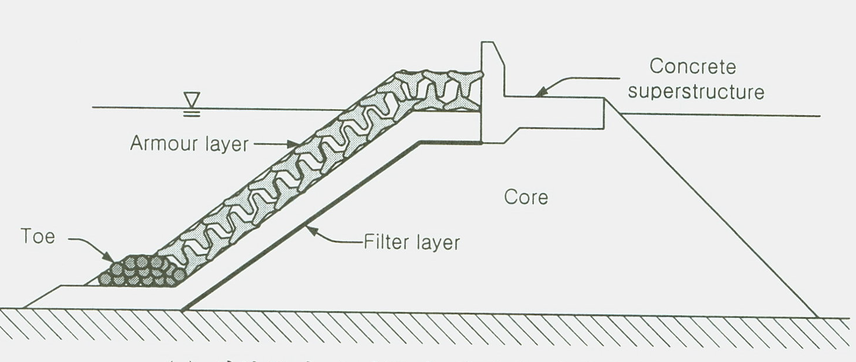
Background and purpose
- Rubble-mound breakwaters are widely used.
- Tetrapod is the oldest (1950) concrete armor unit, but still widely used.
Seoul National University
Stability formula of Tetrapod incorporating slope effect
Notes:
There are different types of breakwaters. Rubble-mound breakwaters are …

Slide 5
Background and purpose
Hudson (1959) :
= wave height,
= relative density of Tetrapod
= nominal size of Tetrapod
= slope angle,
= stability coefficient
Seoul National University
Stability formula of Tetrapod incorporating slope effect
Notes:
Hudson formula has been widely used, which involves wave height, relative density of Tetrapod, nominal size of Tetrapod, slope angle, and stability coefficient.

Slide 6
Background and purpose
Van der Meer (1988) :
= relative damage, = number of waves
= wave steepness (i.e. effect of wave period)
Surging waves on 1:1.5 slope
De Jong (1996) :
Plunging waves on 1:1.5 slope
Seoul National University
Stability formula of Tetrapod incorporating slope effect
Notes:
Van der Meer proposed a new formula, which involves additional parameters: relative damage, number of waves, and wave steepness, that is effect of wave period. This formula, however, was proposed for surging waves on 1:1.5 slope. De Jong proposed a similar formula, which can be used for plunging waves on 1:1.5 slope.

Slide 7
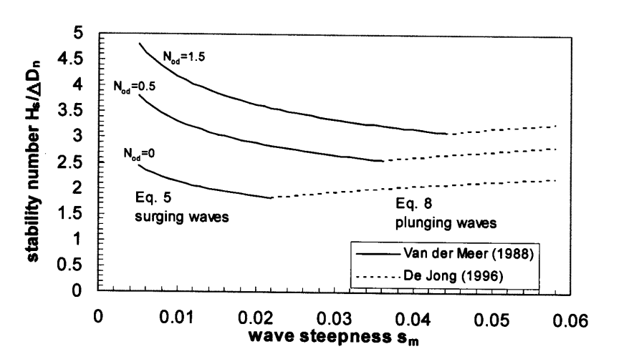
Background and purpose
Van der Meer (2000) :
Recommended using the Van der Meer (1988) and De Jong (1996) formulas as a set of formulas which intersect at the point of minimum stability.
However, these formulas are still useful only for 1:1.5 slope.
Van der Meer
De Jong
Seoul National University
Stability formula of Tetrapod incorporating slope effect
Notes:
Later, Van der Meer recommended using the Van der Meer and De Jong formulas as a set of formulas which intersect at the point of minimum stability as shown in this figure. However, these formulas are still useful only for 1:1.5 slope.

Slide 8
Background and purpose
Purpose of present study (2012) :
Develop a set of formulas which can be used for various structure slopes based on hydraulic model test results of the present and previous studies.
Seoul National University
Stability formula of Tetrapod incorporating slope effect
Notes:
The purpose of the present study is to develop …

Slide 9
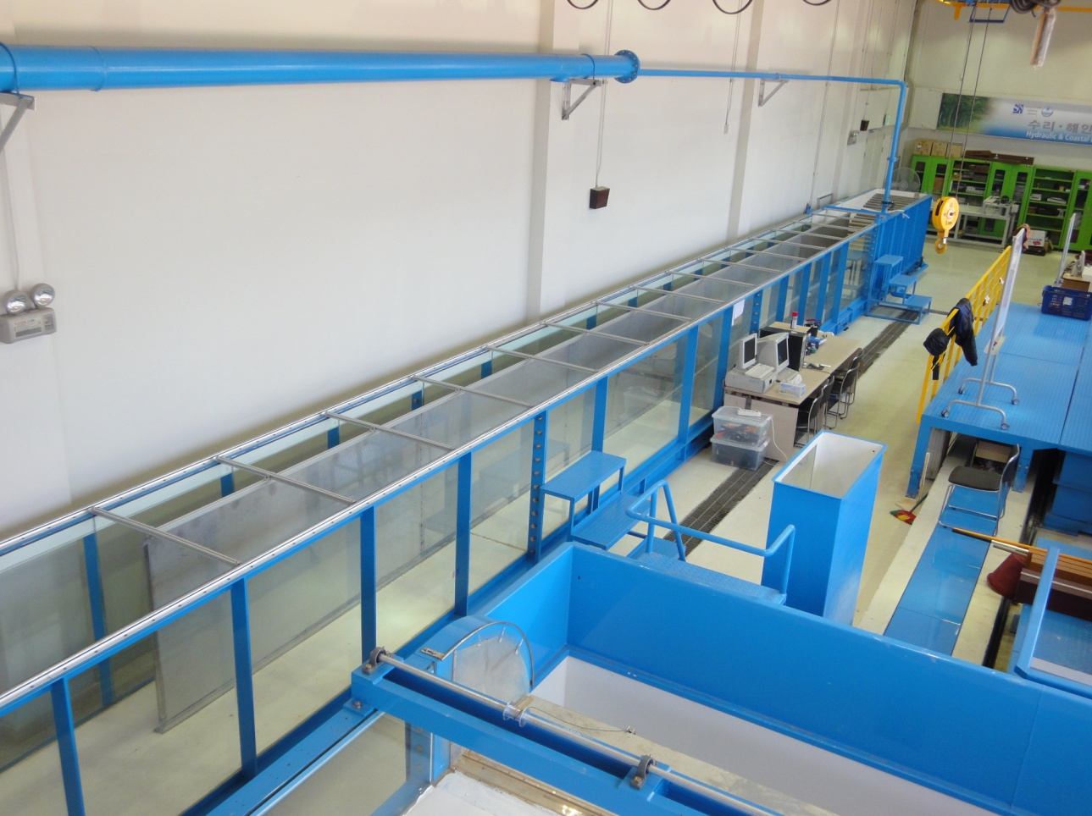
Hydraulic experiment
Wave Flume
▶ Coastal Eng. Laboratory,
Seoul National Univ.
▶ Piston-type wavemaker
▶ Irregular waves
▶ 35 (L), 1.2 (H), 1.0 (W) m
▶ Separation of flume:
- Test section (0.6 m wide)
- Incident wave
measurement (0.4 m wide)
Seoul National University
Stability formula of Tetrapod incorporating slope effect
Notes:
Hydraulic experiment was carried out in the wave flume in Coastal Engineering Laboratory of Seoul National University. Piston-type wavemaker is used to generate irregular waves. Length is 35 m, height 1.2 m, width 1 m. The flume was separated into two parts: test section and incident wave measurement.

Slide 10
Hydraulic experiment
Wave absorber
Wave paddle
Wave gages
Sloping mound
breakwater
Wave absorber
0.6m
1.2m
0.4m
0.2m
2m
3m
12m
7m
5m
3m
3.5m
15m
0.5m
35m
<Side>
Foreshore beach slope: 1:25
Wave absorber
Wave paddle
Wave gages
Sloping mound
breakwater
Wave absorber
1.0m
2m
3m
12m
7m
5m
3m
3.5m
15m
0.5m
35m
<Plan>
Seoul National University
Stability formula of Tetrapod incorporating slope effect
Notes:
This is the side view and plan view of the experimental setup. A sloping bed was installed to include the bottom slope effect. The total water depth was 0.6 m, and the breakwater water depth was 0.4 m. The foreshore beach slope was 1:25. Three wave gauges were used to measure the incident wave.

Slide 11
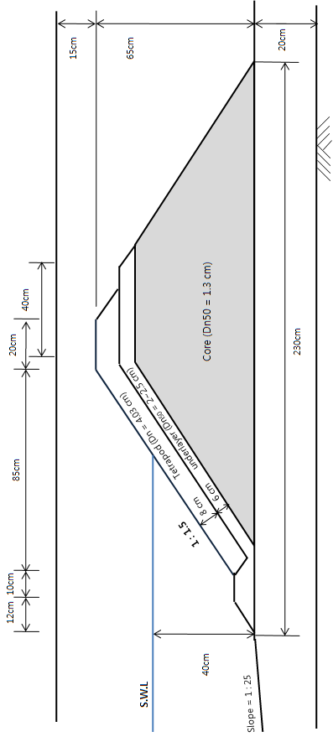
Hydraulic experiment
Breakwater cross-section
Seoul National University
Stability formula of Tetrapod incorporating slope effect
Notes:
This is the cross-section of the breakwater of 1:1.5 slope. The nominal size of Tetrapod was about 4 cm.

Slide 12
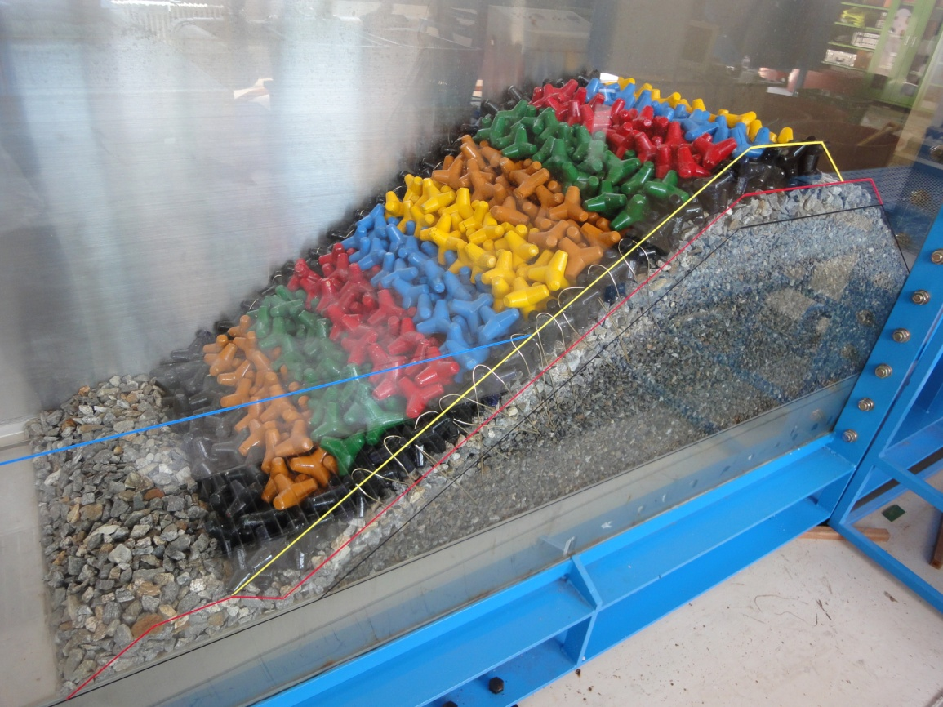
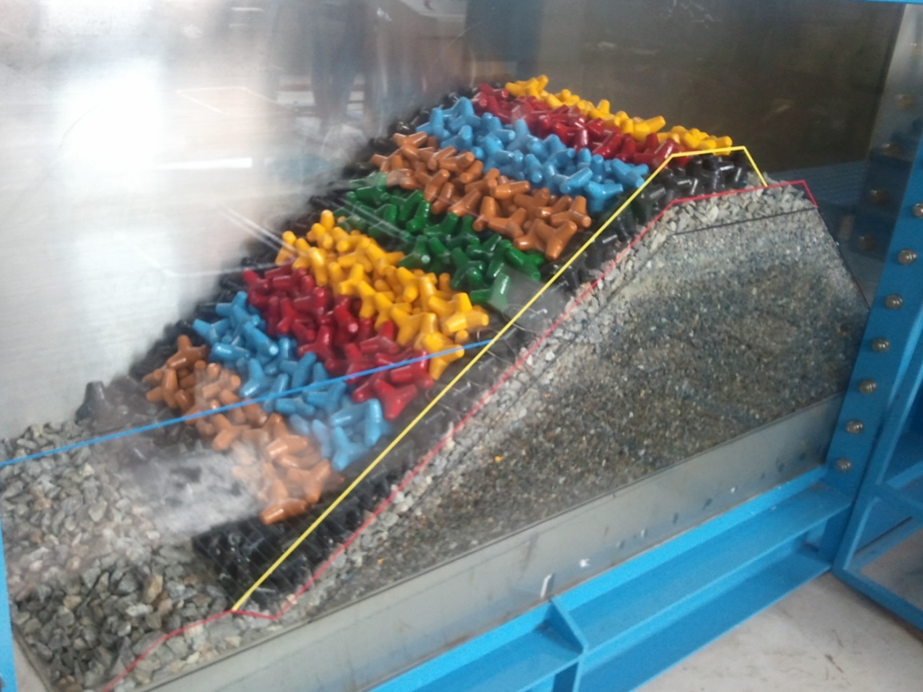
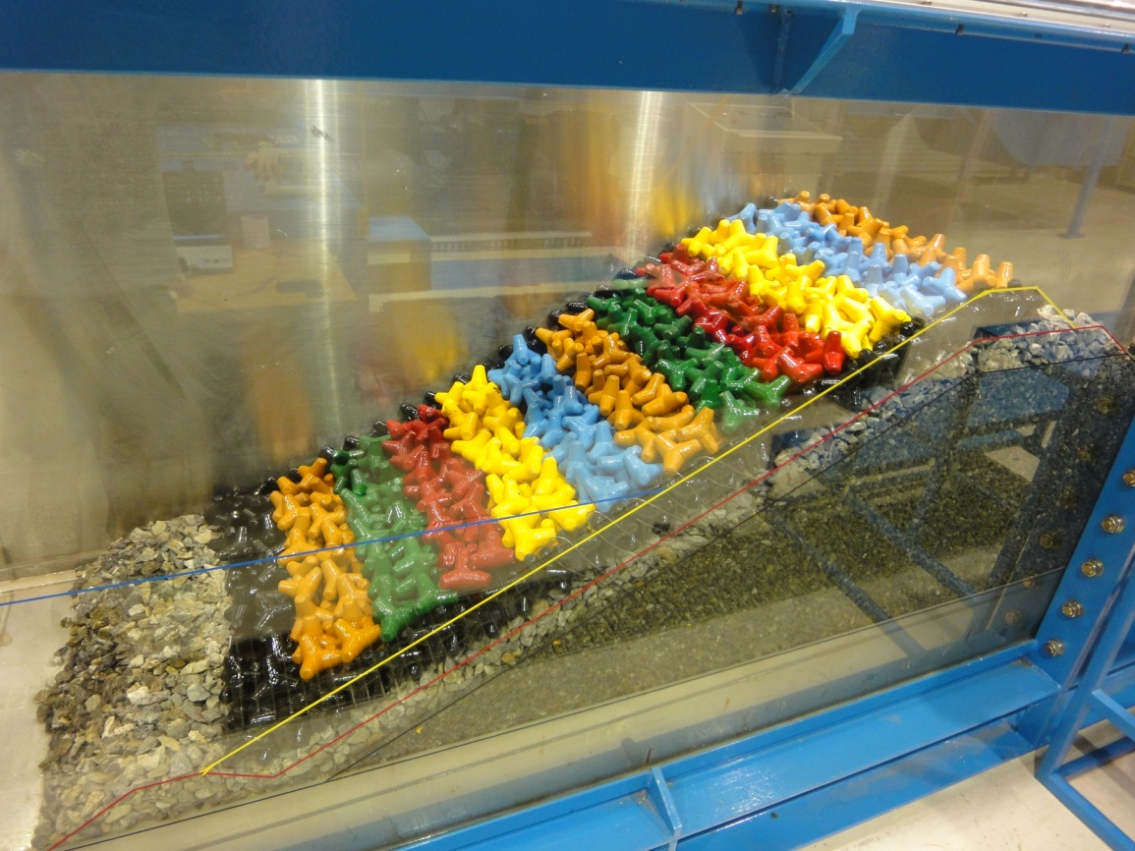
Hydraulic experiment
Tetrapods along the sidewalls were fixed not to move using steel wire, and were not included in the damage calculation.
Slope =1:1.5
1:4/3
1:2
Seoul National University
Stability formula of Tetrapod incorporating slope effect
Notes:
This is the initial profile of 1:1.5 slope. The Tetrapods along the sidewalls were fixed not to move using steel wire, and were not included in the damage calculation. 1:4/3 slope. 1:2 slope.

Slide 13
Hydraulic experiment
Test condition
(3 slope × 4 wave period × 5 wave height = 60 cases)
- Slope ($\cot{θ}$) = 1.33, 1.5, 2.0
- Mean wave period ($T_{z}$) = 1.36 – 2.45 s
- Significant wave height ($H_{s}$) = 9 – 19 cm
Wave steepness ($S_{z}$) = 0.012 – 0.056
Surf similarity parameter (ξ_{z}) = 2.1 – 6.9
Seoul National University
Stability formula of Tetrapod incorporating slope effect
Notes:
We used three different slopes, four different wave periods, and five different wave heights, so total 60 cases were tested. Wave steepness ranges between 0.012 and 0.056, and the surf similarity parameter between 2.1 and 6.9.

Slide 14
Hydraulic experiment
Measurement of damage
A Tetrapod is regarded to be displaced when:
- It moves more than one nominal size
- It comes back to its position after short displacement
- It rotates more than 180 degrees
$$Relative damage (N_{0})=\frac{Total number of displaced Tetrapods}{Width of test section/D_{n}}$$
Seoul National University
Stability formula of Tetrapod incorporating slope effect
Notes:
A Tetrapod is regarded to be displaced when …

Slide 15
Hydraulic experiment
Movie of a test
Seoul National University
Stability formula of Tetrapod incorporating slope effect
Notes:
This is a movie of a test.

Slide 16
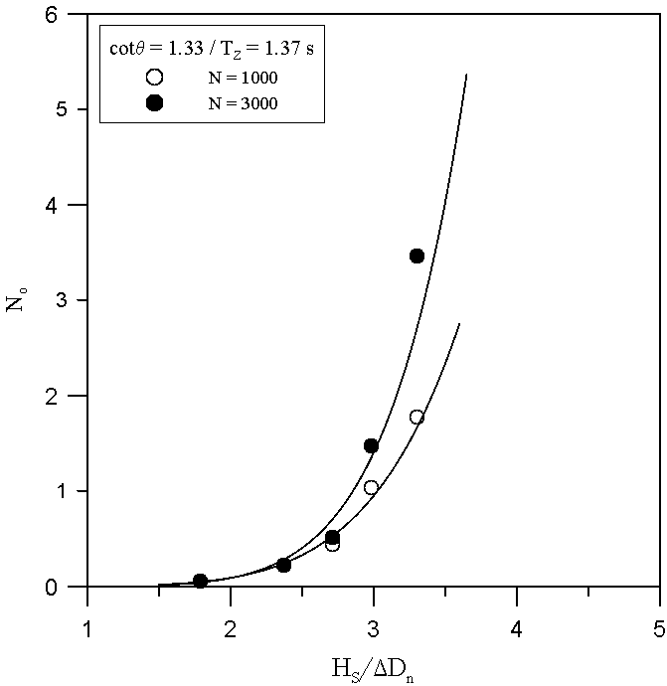
Development of stability formula
Follow the method of Van der Meer (1987) for rock armor
Draw a damage curve for each $θ$, $T_{z}$, and $N$
Read $N_{s}=H_{s}/∆D_{n}$ for $N_{0}=$ 0, 0.5, and 1.5
Seoul National University
Stability formula of Tetrapod incorporating slope effect
Notes:
For development of stability formula, we followed the method of Van der Meer for rock armor. First, draw a damage curve for each theta, Tz, and N. Then read the stability number for N0 of zero, 0.5, and 1.5.

Slide 17
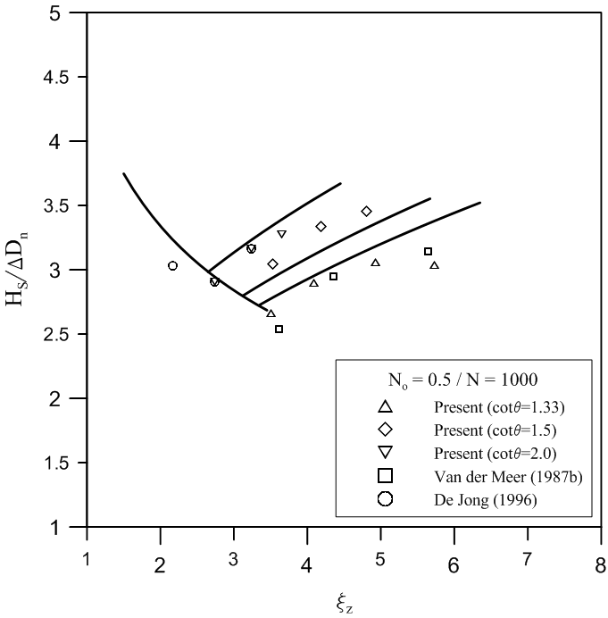
Development of stability formula
Plot $H_{s}/∆D_{n}$ versus ξ_{z} for 6 cases ($N_{0}=$ 0, 0.5, 1.5; $N=$ 1000, 3000)
The data of Van der Meer (1988) and De Jong (1996) are also used
Plunging wave:
Surging wave:
Determine the coefficients (a, b, c, d) by using regression analysis
Surging
Plunging
Seoul National University
Stability formula of Tetrapod incorporating slope effect
Notes:
Then we plot the stability number versus surf similarity parameter for 6 cases of different N0 and N. The data of Van der Meer and De Jong were also used. We assume the plunging wave formula and surging wave formula in this form, and we determine the coefficients a, b, c, d by using regression analysis.

Slide 18
Development of stability formula
New stability formula for Tetrapod:
Plunging formula
Surging formula
cot$θ=$ 2.0 1.5 1.33
Seoul National University
Stability formula of Tetrapod incorporating slope effect
Notes:
This is the new stability formula for Tetrapod. We have a plunging formula which is decreasing with the surf similarity parameter and surging formula which is increasing with the surf similarity parameter. We have to use the maximum of these in the design.

Slide 19
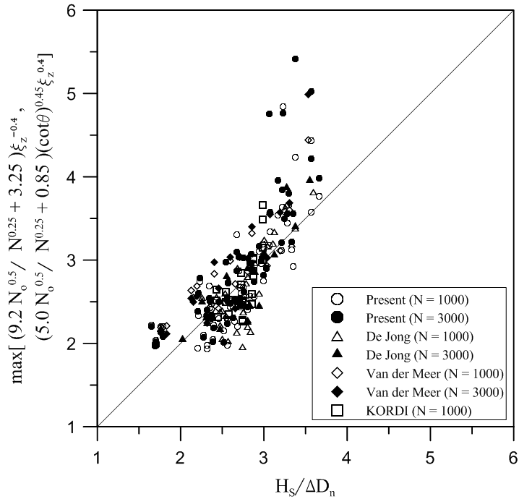
verification of stability formula
Over-prediction:
cotθ=1.33 Steep slope
Hs/∆Dn>3.0 High waves
N=3000 Long storm duration
Willmott’s Index of Agreement = 0.843
Seoul National University
Stability formula of Tetrapod incorporating slope effect
Notes:
This figure shows the calculated stability number versus measured stability number for all the data of present, De Jong, Van der Meer, and KORDI data. Over-prediction is observed for steep slope, high waves, and long storm duration. The index of agreement is 0.843.

Slide 20
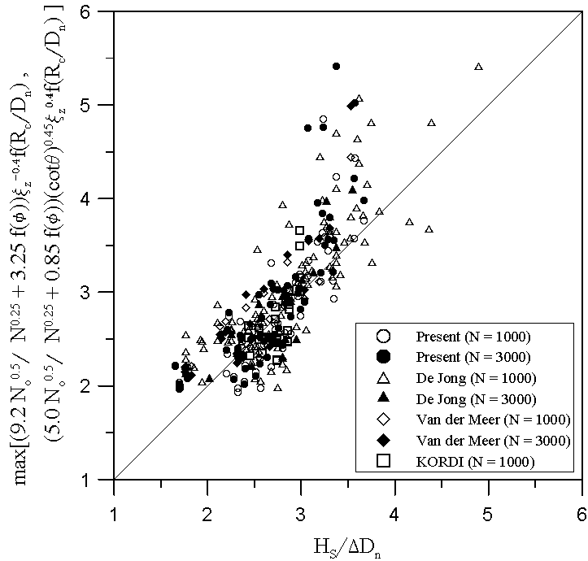
verification of stability formula
Including the data of low packing density and low-crest breakwater of De Jong (1996)
Index of Agreement = 0.857
Better than previous comparison without low packing density and low-crest breakwaters
Seoul National University
Stability formula of Tetrapod incorporating slope effect
Notes:
This is a comparison including the data of low packing density and low-crested breakwater of De Jong. The packing density function and crest elevation function is included in the stability formula. The index of agreement is 0.857. This is better than previous comparison without low packing density and low-crest breakwaters.

Slide 21
uncertainty of stability formula
Reliability function of the new formula:
$a$ is a variable signifying the uncertainty of the formula
Plot a histogram of $a$ using the experimental data
Assume normal distribution of $a,$ and calculate the mean and standard deviation
mean = 0.96, standard deviation = 0.13
Seoul National University
Stability formula of Tetrapod incorporating slope effect
Notes:
To estimate the uncertainty of the stability formula, the reliability function of the new formula is expressed in this way. Here ‘a’ is a variable signifying the uncertainty of the formula. We plot a histogram of ‘a’ using the experimental data. Assume normal distribution of ‘a’, and calculate the mean and standard deviation. The mean is 0.96, and the standard deviation is 0.13.

Slide 22
conclusion
A new stability formula was developed for Tetrapod armor layer
Can be used for different slope angles
Can be used for low packing density and low-crest breakwaters as well
Over-predicts the stability number in the case where a steep breakwater is designed for a storm of large wave height and long storm duration
Uncertainty of the formula: bias=-0.04, coefficient of variation=0.14
Seoul National University
Stability formula of Tetrapod incorporating slope effect
Notes:
This is the conclusion of this study…

