Slide 1


Incorporation of Continental and Urban Run-off into a Coastal Circulation Model: Application to the Catalan Coast
M. Liste, M. Grifoll, I. Keupers, J. Monbaliu, M. Espino

Slide 2

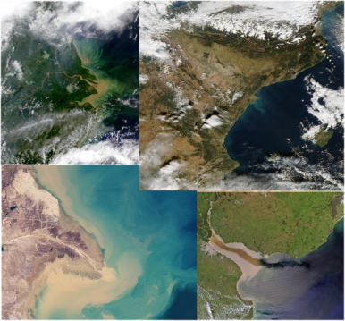
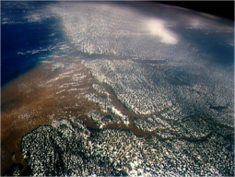
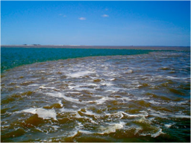
Motivation
Coastal oceans are the recipient of freshwater and land materials
Freshwater discharges from rivers and urban outflows to the ocean have deep effects (on the physical, chemical, and biological processes) in coastal waters.
Most studies on freshwater influence into the coastal sea have focused on estuarine environnements but continental/urban runoff has been rarely considered in coastal circulation.
Examples of satellite images of river mouths
a good understanding of the mixing and transport processes in river plumes is required for the maintenance of coastal ecosystems and their resources.
Boundaries between river and sea

Slide 3
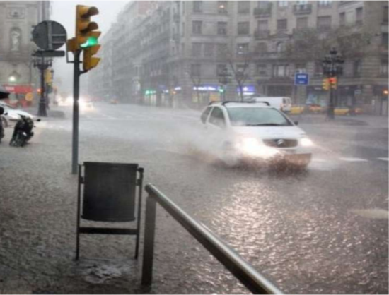
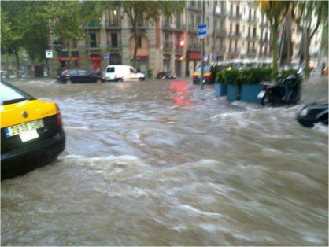
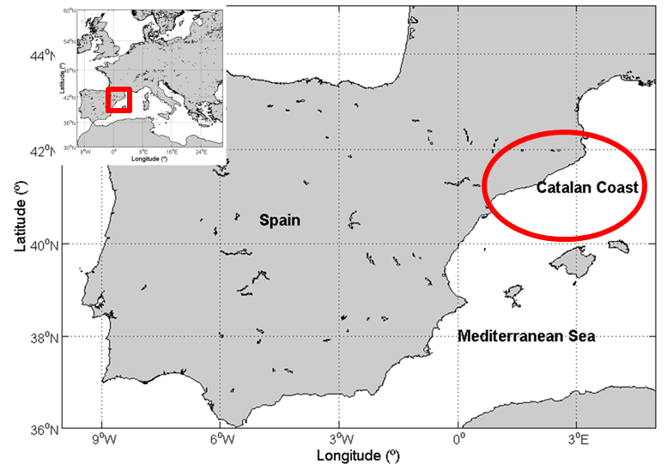
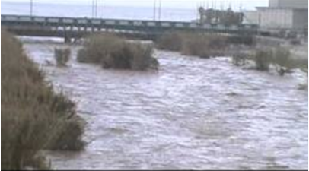
Motivation
In the Catalan coast the combination of:
local topography
torrential rainfall
General objective:
to implement the land boundary fluxes into a coastal circulation model
local runoff on a short time
large impact on coastal waters
Flooding in Barcelona city during a Storm. 2011
Besòs River runoff after a Barcelona Storm. 2011

Slide 4
Outline
1.Data Needs
2.Numerical model and initialization
  2.1.Coastal Circulation Model
  2.2.Model Setup
2.2.1.Domain
2.2.2.Boundary conditions
2.2.3.Forcing
      2.2.3.1.Atmospheric forcing
      2.2.3.2.Initial condition-sea boundary condition
      2.2.3.3.Land forcing (Rivers and urban runoff)
3.Validation
  3.1.Field_AC campaign
  3.2.Satellite image
4.Results
5.Conclusion and Future Work

Slide 5
1. Data Needs
INPUTS
OUTPUTS
Coastal model grid
Initial Conditions
Ocean Boundary Conditions
Land Boundary Conditions
Ocean Forcing
Salinity 3D
Temperature 3D
Currents 3D
Free Surface
.........
Coastal Model

Slide 6
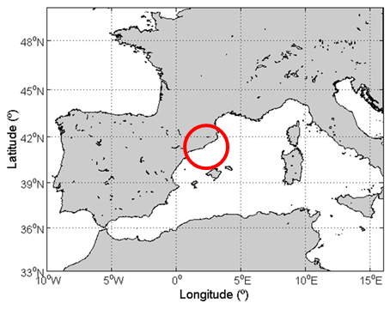
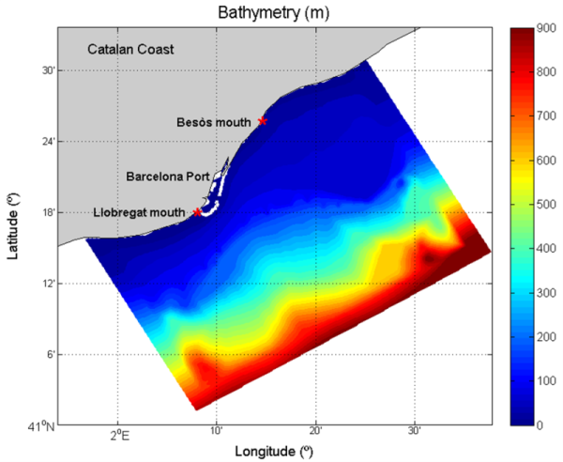
2. Numerical Model and Initialization
2.1 Coastal Circulation Model
  ROMS (Regional Ocean Model System). (Shchepetkin and McWilliams, 2005)
  vertical coordinates (σ)
  low-order finite difference scheme
2.2 Model Setup
2.2.1. Domain
  High Resolution Bathymetry
  152 x 207 grid cells
  250m x 250m of horizontal resolution
  20 sigma vertical levels

Slide 7
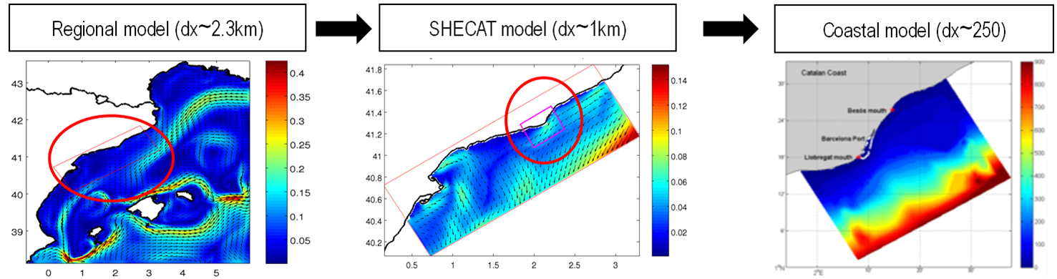
2. Numerical Model and Initialization
2.2 Model Setup
2.2.2. Boundary Conditions
  Nested increasing/resolution domains

Slide 8
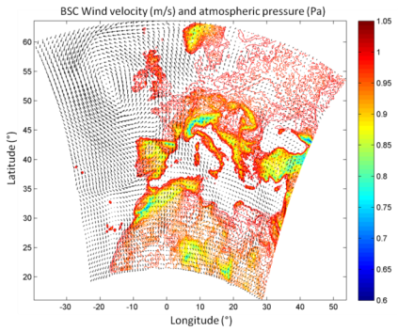
2. Numerical Model and Initialization
2.2 Model Setup
2.2.3. Forcing
a) Atmospheric forcing
  Barcelona Super Computing Center
  1 km of resolution

Slide 9
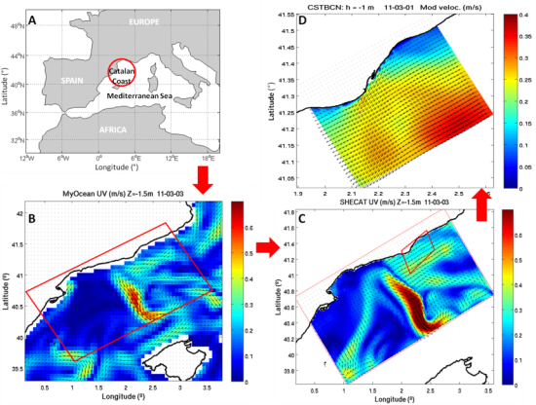
2. Numerical Model and Initialization
2.2 Model Setup
2.2.3. Forcing
b) Initial and Sea Boundary Condition
        MyOcean project
(http://www.myocean.eu)

Slide 10
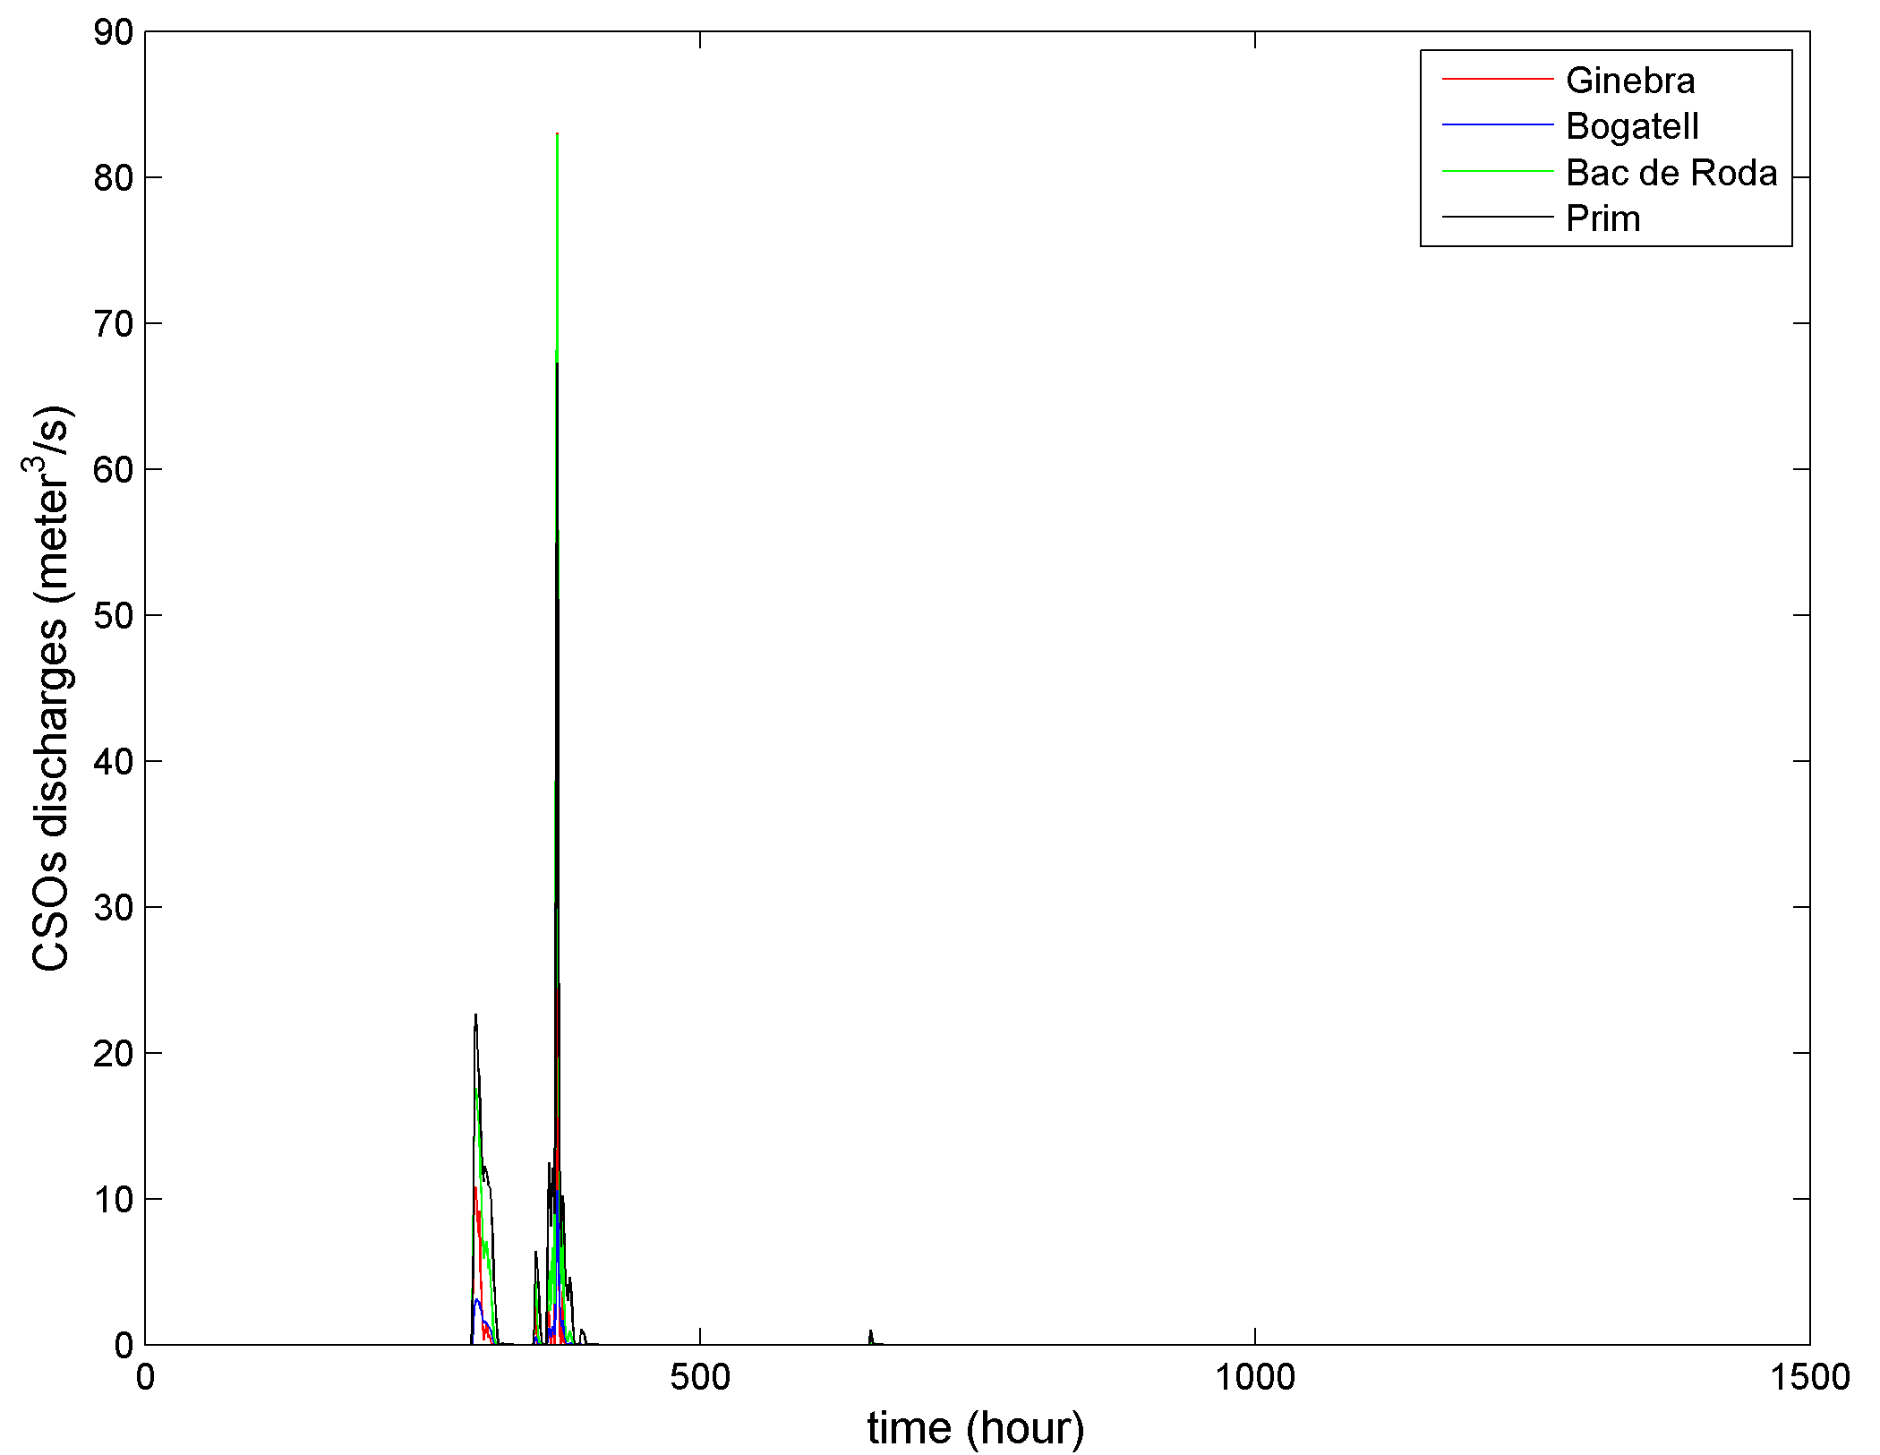
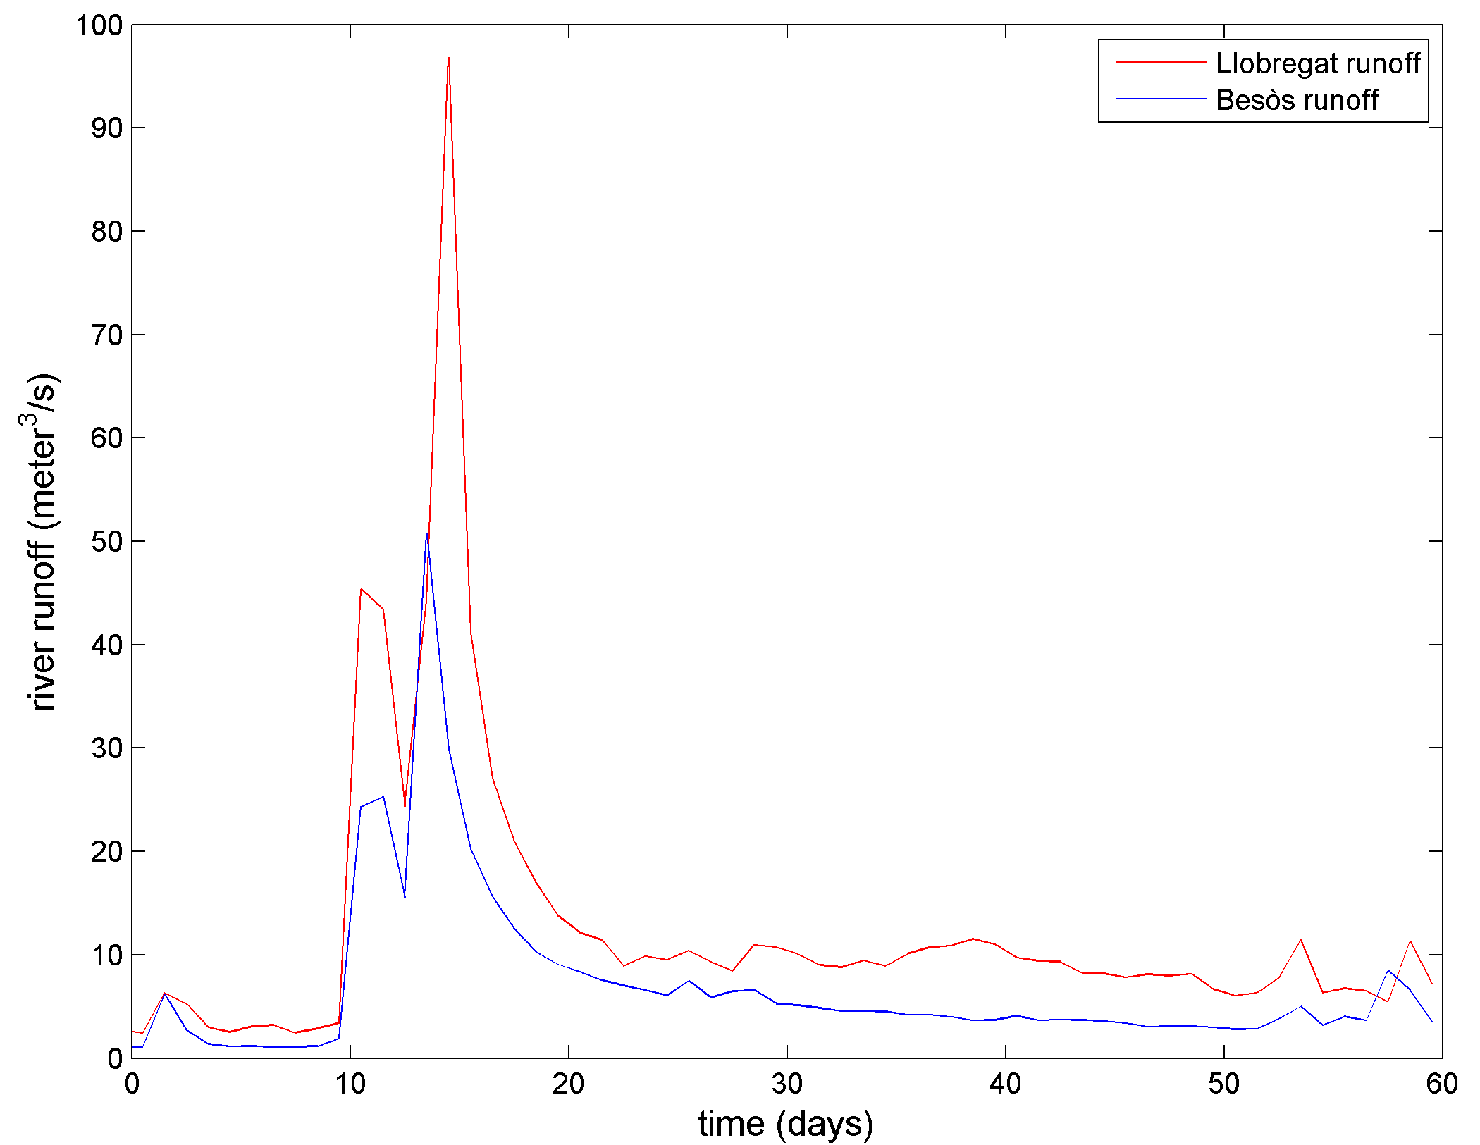
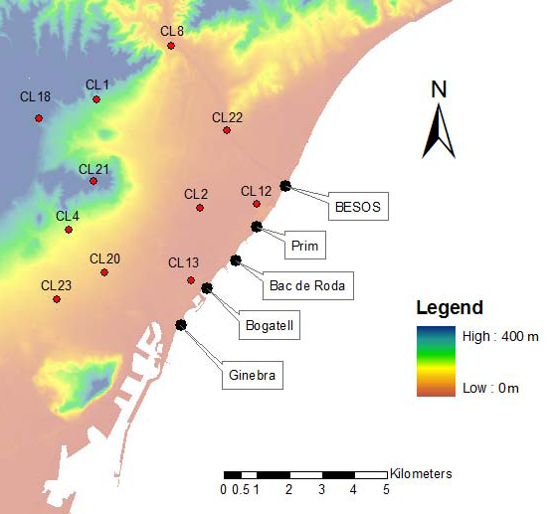
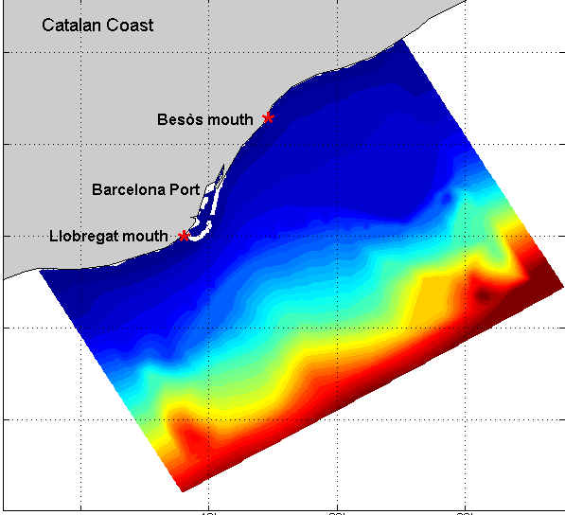
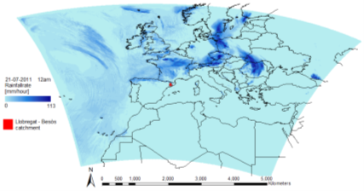
2. Numerical Model and Initialization
2.2 Model Setup
2.2.3. Forcing
c) Land forcing
-Rivers: Llobregat, Besòs
-CSOs: Ginebra, Bogatell, Bac de Roda and Prim
CALIOPE air quality Model (BSC)
River runoff into the Coastal model
CSOs into the Coastal model
Flow temporal series (m³/h)
River basin Rainfall – runoff Model (KUL)
Combined Serwer Overflow Model (KUL)
(Keupers et al., 2011)
Accumulate Rainfall per hour

Slide 11
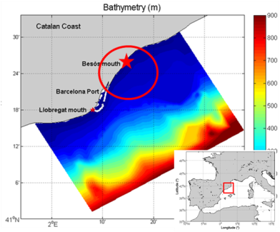
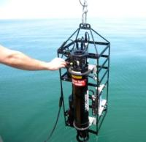
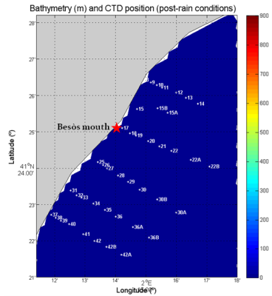
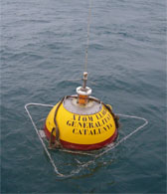
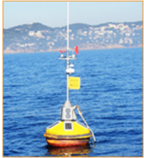
3. Validation
3.1 Field Campaign CTD, Currents and Waves measurements in the Besòs River area
43 CTD profile measurements during a ‘storm' period, corresponding to 17/Mar/2011.
42 CTD profile measurements during a 'normal' (i.e., dry) period, corresponding to 11/Apr/2011
Example of CTD
Examples of buoys.
(Source: XIOM 2010)

Slide 12
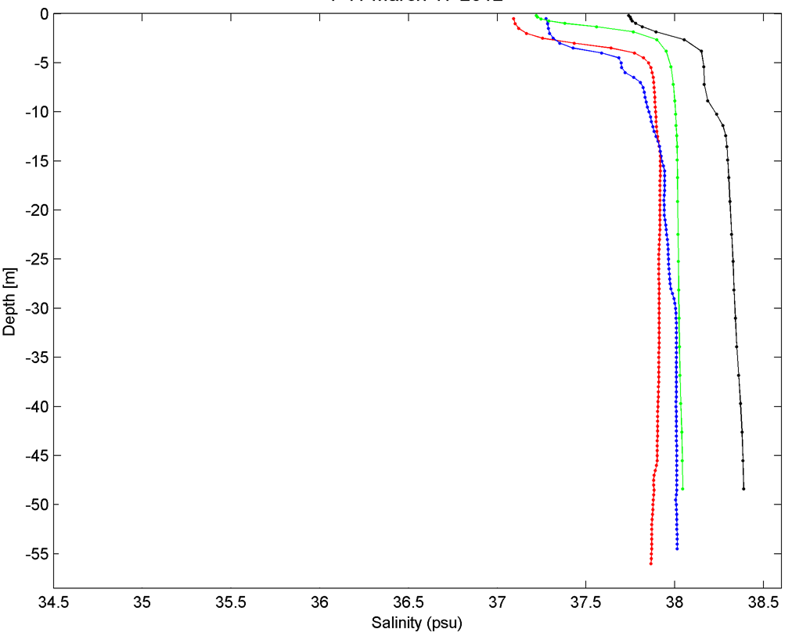
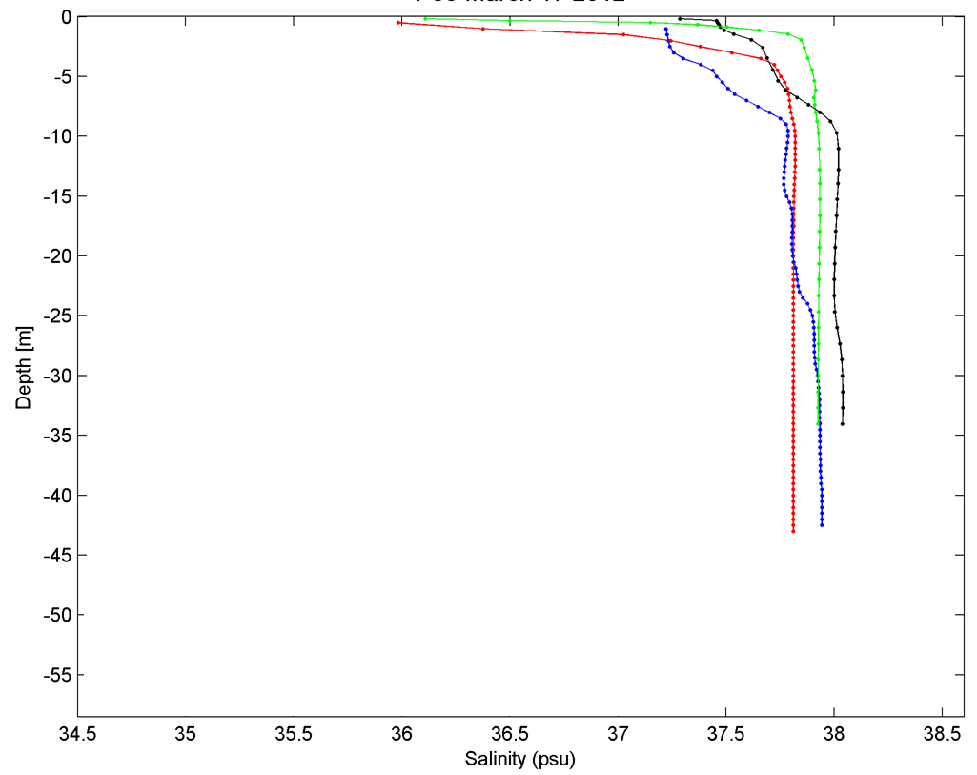
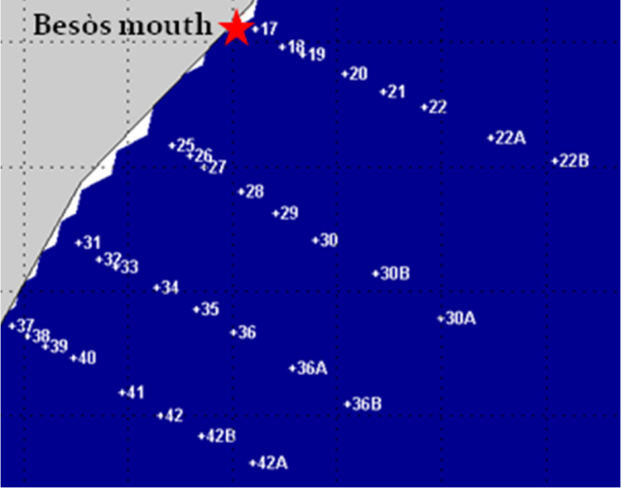
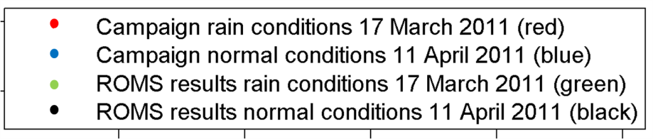
3. Validation
CTD Versus ROMS Profiles
(Besòs River Area)
P41
P33

Slide 13
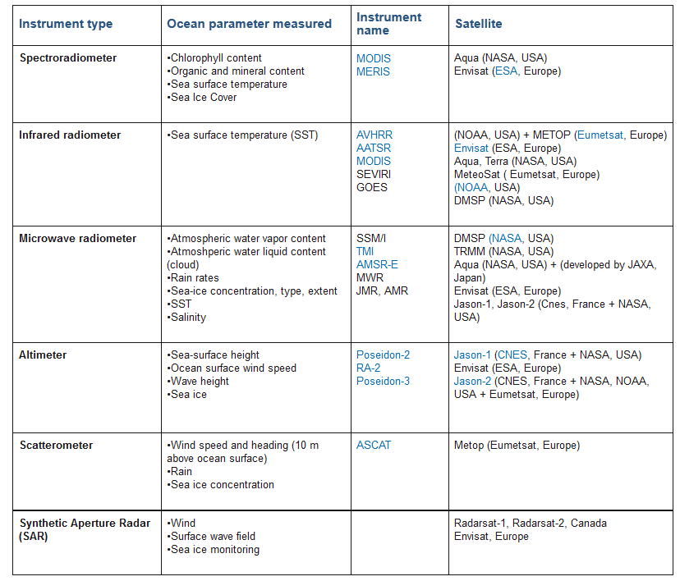
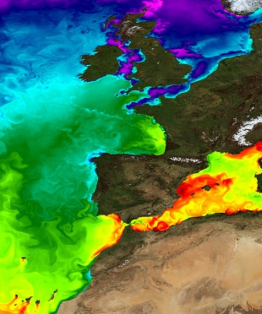
3. Validation
3.2 Remote Sensing
Measurements from :
MODIS and MERIS
The combination of:
  satellite ocean data
  in situ coastal ocean measurements
  use of numerical models
offer great opportunity to improve the validation of the numerical
model results
Sea surface temperature centred on the Alboran Sea.
(Source: MyOcean project)

Slide 14
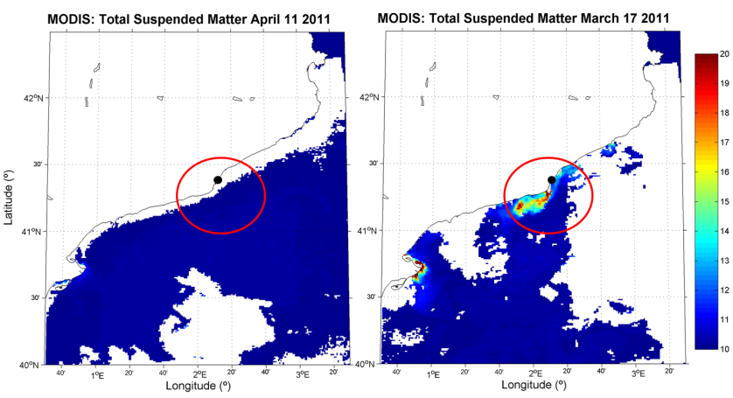
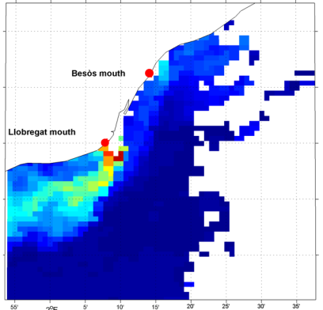
3. Validation
TSM From MODIS
(MODerate resolution Imaging Spectroradiometer (data provided by MUMM))
Catalan Coast area
Zoom area

Slide 15
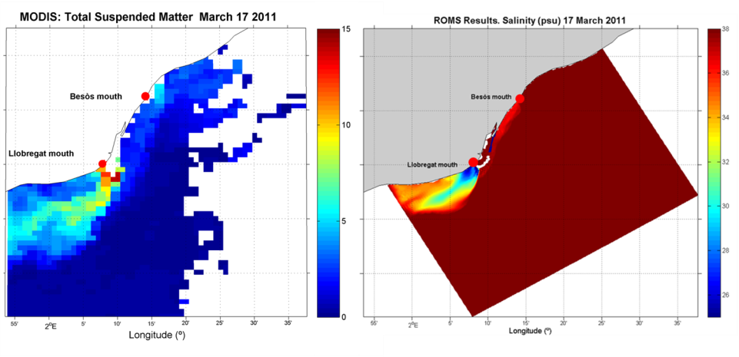
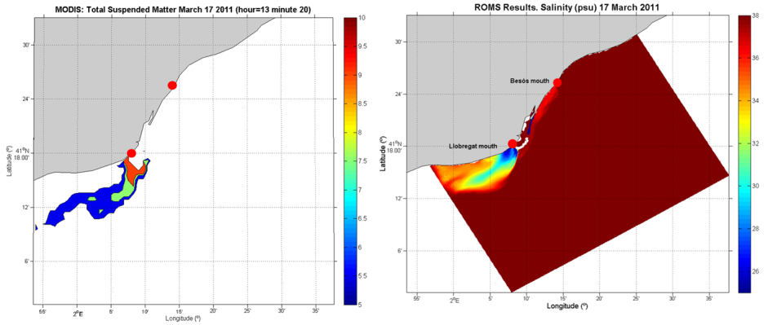
3. Validation
TSM From MODIS versus Salinity from ROMS results
(March 17TH 2011)
Catalan Coast Zoom area

Slide 16
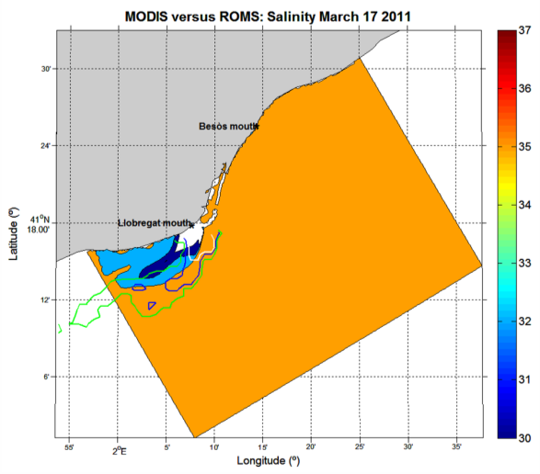
3. Validation
TSM (MODIS) Overlay into the Salinity (ROMS results)
(March 17TH 2011)
Catalan Coast area

Slide 17
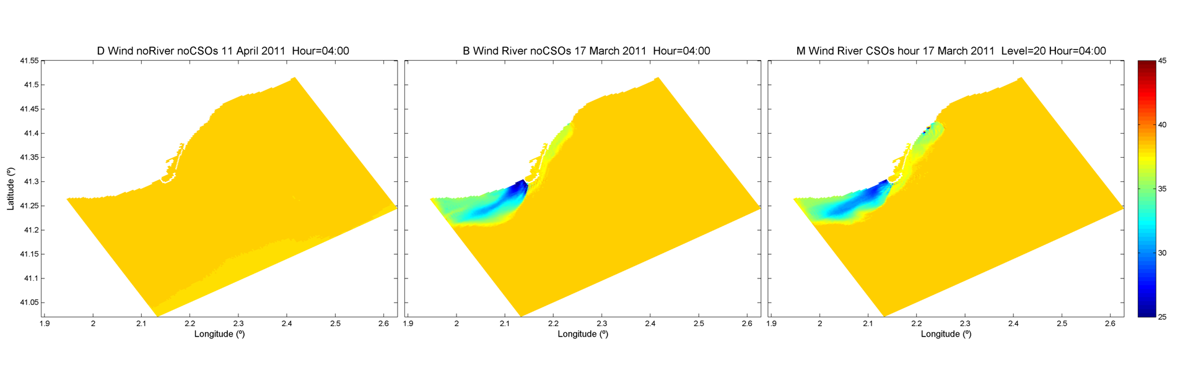
4. Results
Response of plume to the land discharges
without land discharges
River runoff
River+CSOs runoff

Slide 18
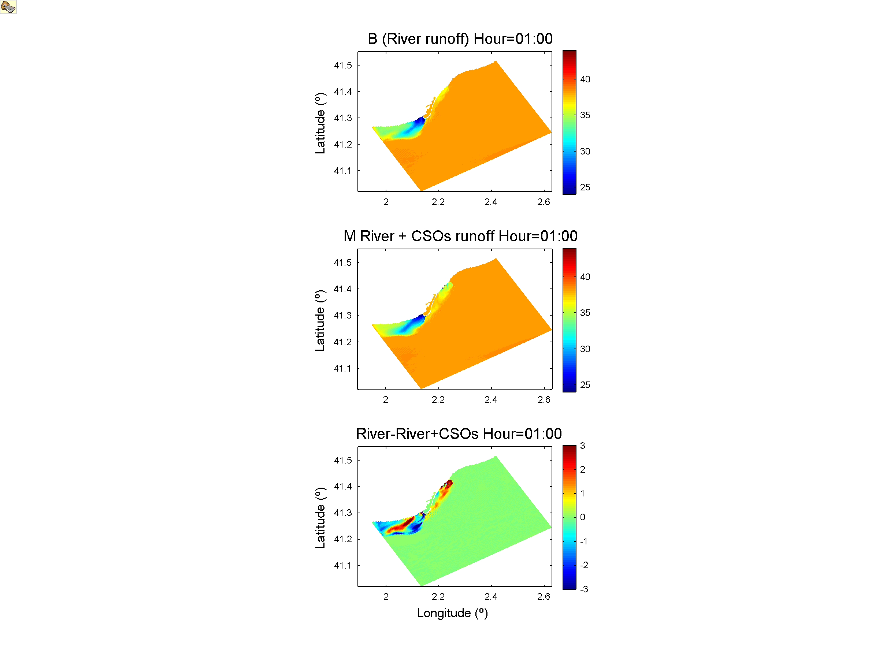
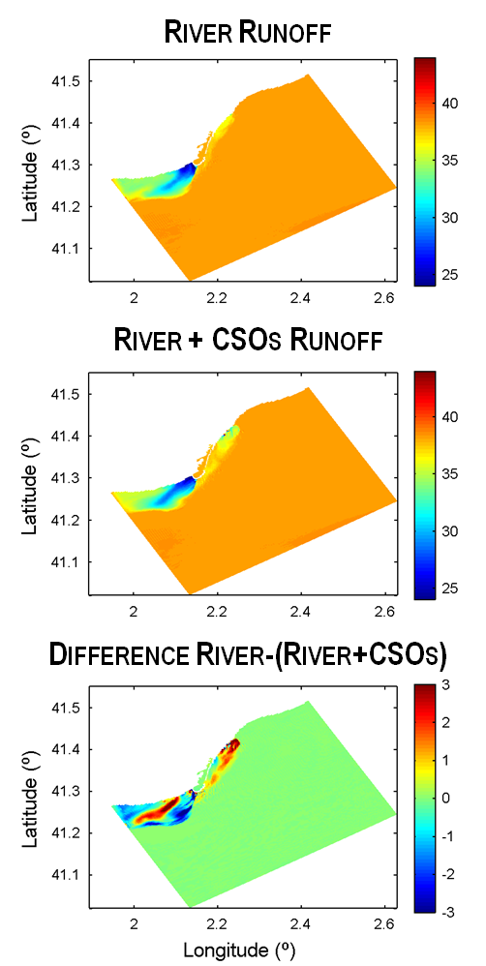
4. Results
Land Discharge
Differences
March 17th
Land Discharge
Differences
March 17th

Slide 19
4. Results
Land boundary fluxes (river and urban runoff) have been implemented into the coastal circulation model
the results from a coastal circulation model (ROMS) have been compared with campaigns data and satellite observation to the Catalan Coast area:
  the validation has proved that ROMS model reproduce the freshwater inflow
  the salinity profiles from campaign versus model validation are shown a similar behavior, but the values of the salinity (ROMS) are overestimated.
the ROMS result plume has qualitative similarities with the satellite observation data
  the shape of the salinity plume from ROMS has similarities with the total suspended matter plume observed in the Satellite data.

Slide 20
5. Conclusion
Different study cases have been compared:
Profile of the freshwater discharges play an important role in the plume dispersal:
  Freshwater discharges affect to the plume location, structure and dispersal.
  Overflows discharge impact have been detected in the Coastal grid (250x250 m of resolution)

Slide 21
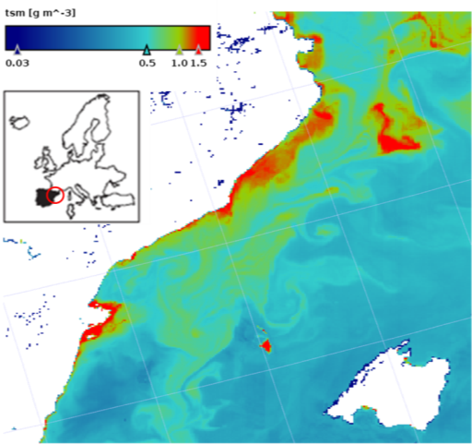
6. Future Work
to analyze in deep the correspondence between the campaign data CTD profiles and ROMS
profile results.
to compare the salinity ROMS results with a Yellow Substance Database
to run ROMS model including the sediment
transport module and the water quality module
Total suspended matter in the Catalan coast
(Source : MERIS satellite image. ESA).

Slide 22

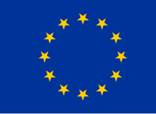




End
Acknowledge:

